Slide 1
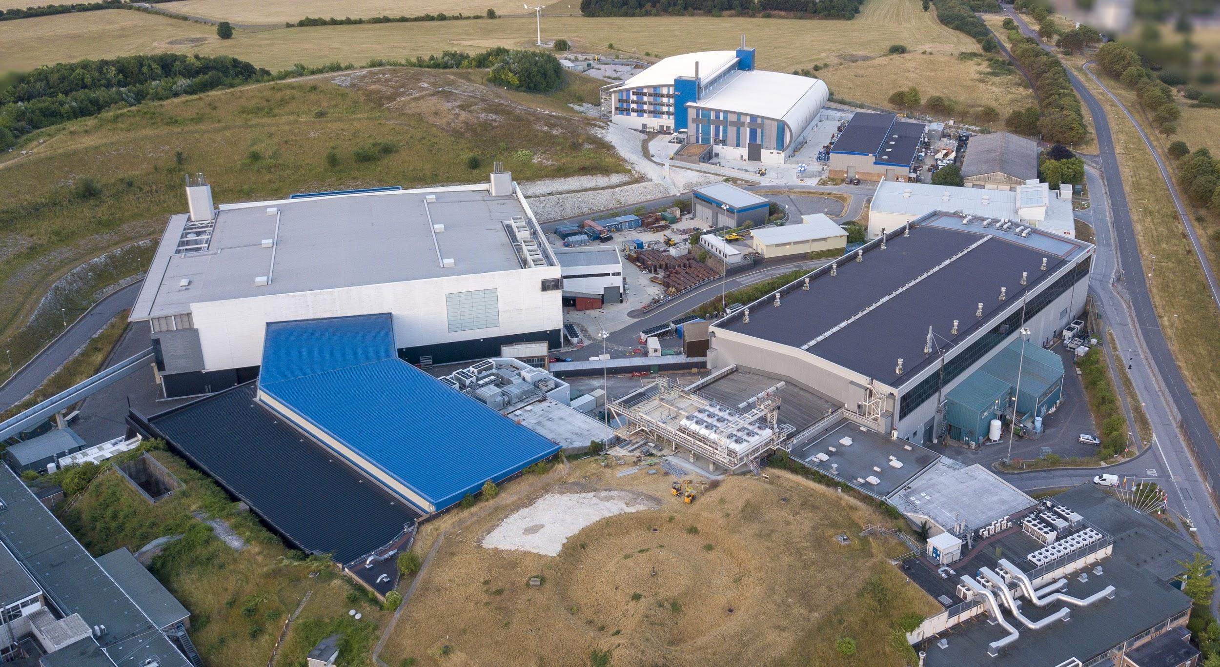



Slide 2



SasView:
A ‘Swiss Army Knife’ for SAS Data Analysis
Dr Stephen King

Slide 3

Outline
1 What is Data Analysis?
And what it is not!
2 Data Formats
A possibly dull, but important, consideration!
3 Options for Data Analysis
Where to start!
4 The SasView Collaboration
And how you can contribute!
5 Demonstrations of SasView
Including Model-Fitting 101
6 Questions?
Newby, Hamley & King (2007)

Slide 4


What is Data Analysis?
Notes:
Let’s ask Google…

Slide 5
Two quotes…
“Data analysis is a process of inspecting, cleansing, transforming, and modeling data with the goal of discovering useful information, informing conclusions, and supporting decision-making.”
Wikipedia
“…a way of drawing inductive inferences from data and distinguishing the signal (the phenomenon of interest) from the noise (statistical fluctuations) present in the data…”
Shamoo & Resnik (OUP, 2003)
Key:
outcomes
methods
issues
Notes:
Learning something from our data, through a process of interpretation, mindful that the data may have limitations

Slide 6
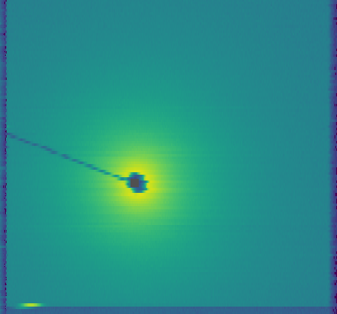
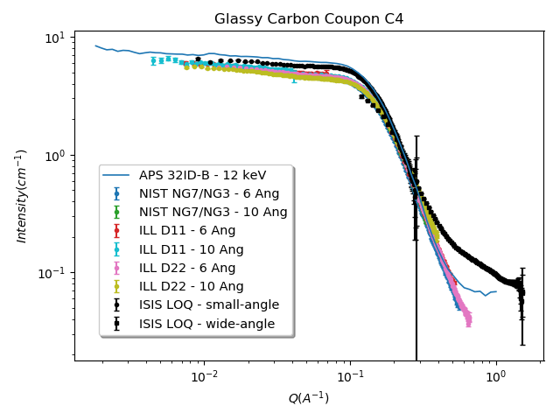
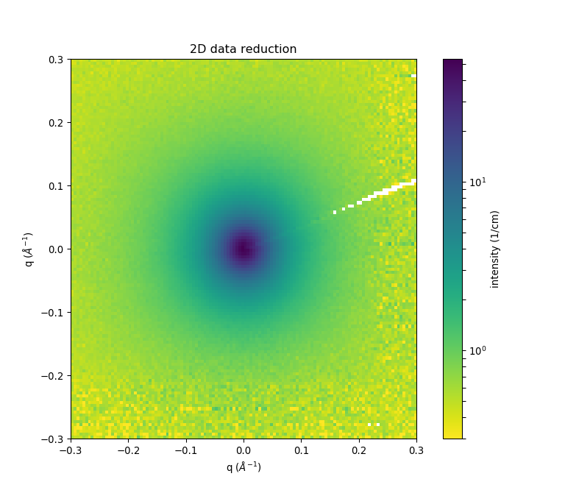
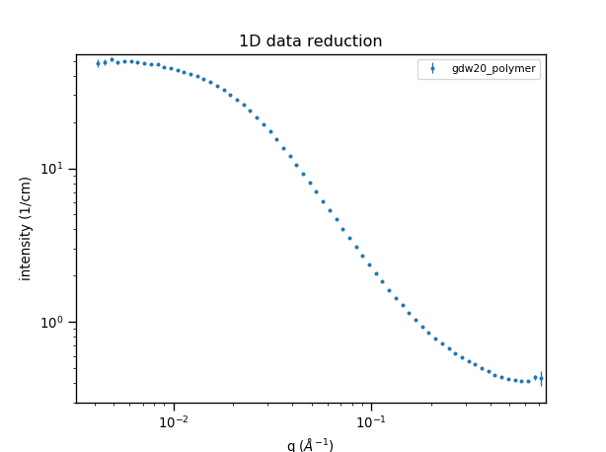
Experimental Data Flow
Reduced data should be reproducible anywhere!
Data Acquisition System
Instrument-
dependent
data
‘raw’ data file
(NXS)
Data Reduction Programs
(e.g. Mantid)
Instrument-
independent
data
reduced data file
(1D: HDF / XML / TXT; 2D: HDF / TXT)
Data Analysis Programs
http://www.cansas.org
Paper / Thesis
Notes:
Penultimate step in a ‘data processing pipeline’

Slide 7
Reduced Data Formats

Slide 8
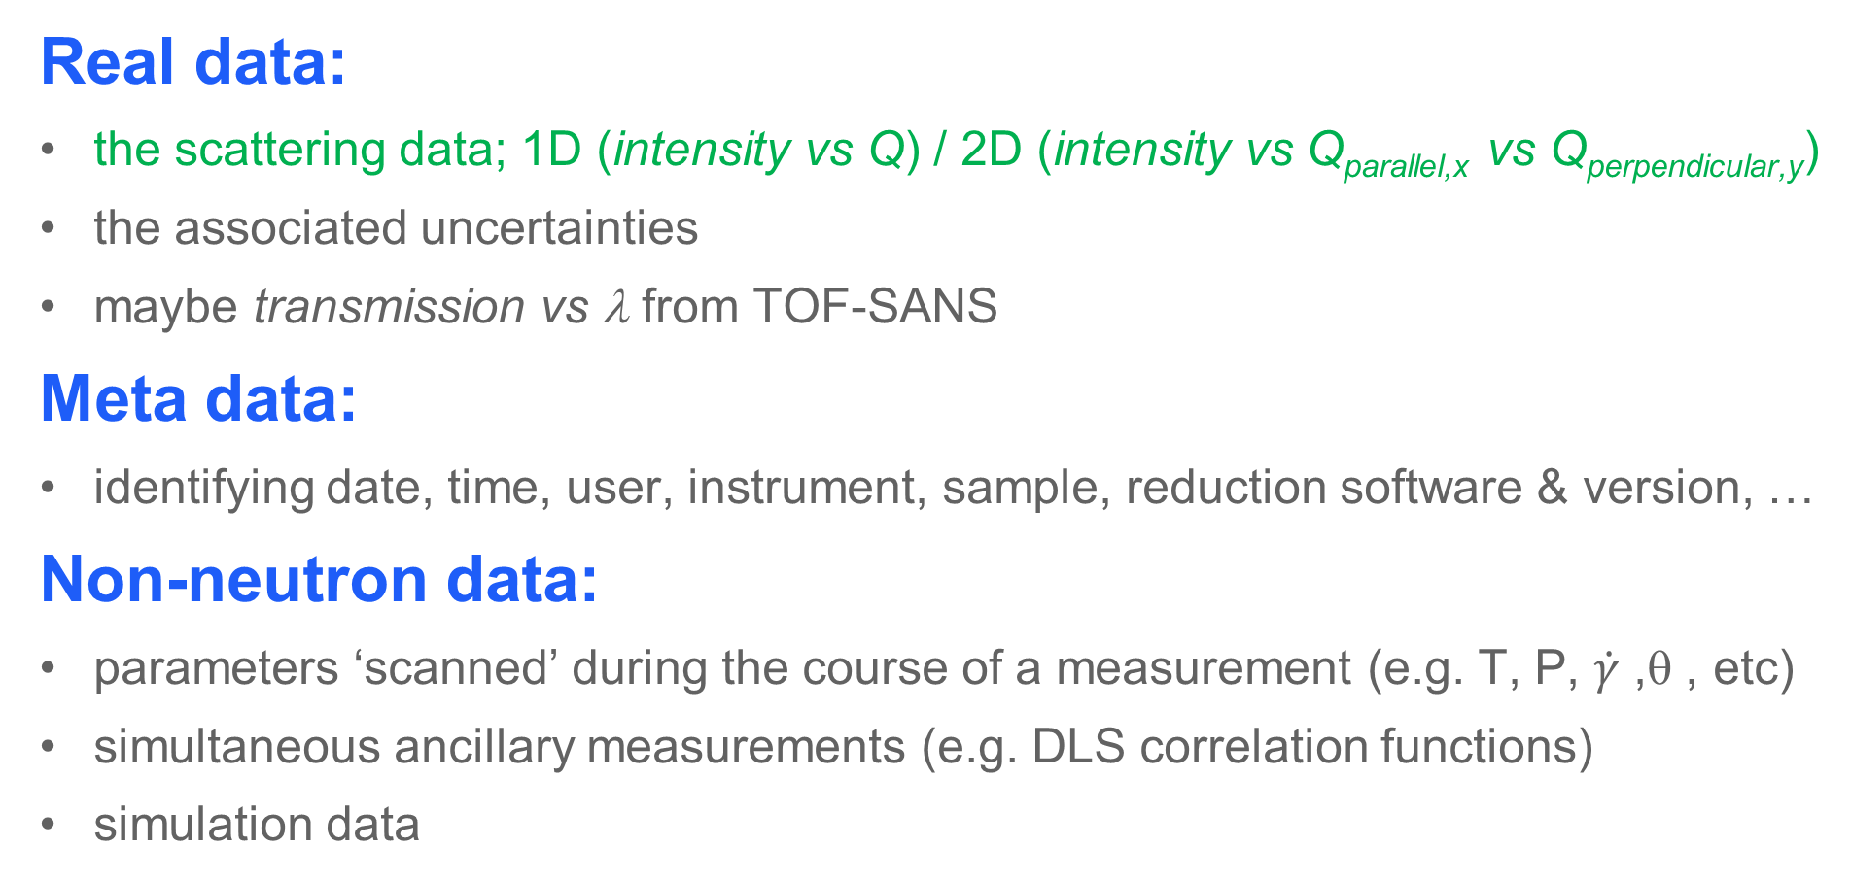
Possible Types of Data
Real data:
the scattering data; 1D (intensity vs Q) / 2D (intensity vs Q_{parallel,x} vs Q_{perpendicular,y})
the associated uncertainties
maybe transmission vs λ from TOF-SANS
Meta data:
identifying date, time, user, instrument, sample, reduction software & version, …
Non-neutron data:
parameters ‘scanned’ during the course of a measurement (e.g. T, P, $\dot{γ}$, θ, etc)
simultaneous ancillary measurements (e.g. DLS correlation functions)
simulation data
Notes:
The scattering data is but one element of a potentially much larger set of information

Slide 9
Possible Types of Data Format
‘Minimalist’ (e.g. ‘plain text’, TXT, DAT, CSV*):
typically just contains some numbers + a header if you are lucky!
Self-describing (e.g. XML, CanSAS1D):
uses ‘tags’ to order and describe the data/metadata to an agreed structure
Hierarchical (e.g. HDF, NXcanSAS):
also self-describing, but fully portable (no outside information needed)
can contain a mix of data types (‘a file-system-in-a-file’)
SasView inputs many of these (and more)!
* Beware the semi-colon ; !

Slide 10


The CanSAS Standards
CanSAS1D
NXcanSAS
v1.0 released May 2009
v1.1 released Mar 2013
for 1D reduced data only
XML-based (.xml)
still human-readable
http://www.cansas.org/formats/canSAS1d/1.1/doc/
v1.0 released Jan 2017
for nD reduced data
HDF5-based (.h5)
NeXus-structured
not human-readable
http://www.cansas.org/wgwiki/index.php/NXcanSAS
https://www.nexusformat.org/
https://www.hdfgroup.org/downloads/hdfview/ (free!)
Notes:
Show some files

Slide 11
Options for SAS Data Analysis

Slide 12
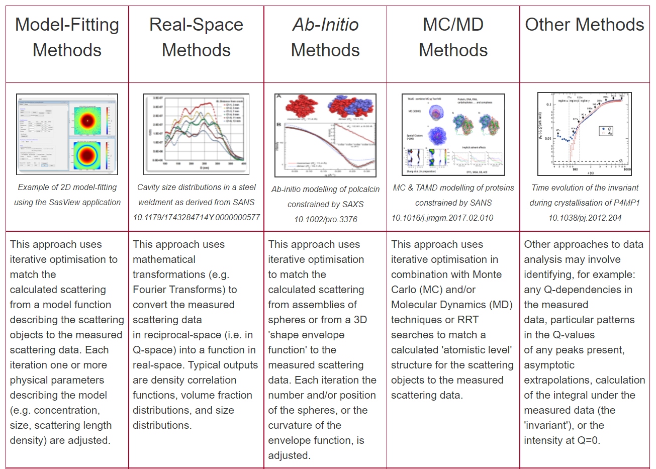
Many Options!
But:
not every option is needed every time!
often one option will suffice
Influences:
what you want to know
the data quality
your field/speciality
https://www.isis.stfc.ac.uk/Pages/SANSdataanalysisOverview.aspx

Slide 13
The SasView Collaboration

Slide 14
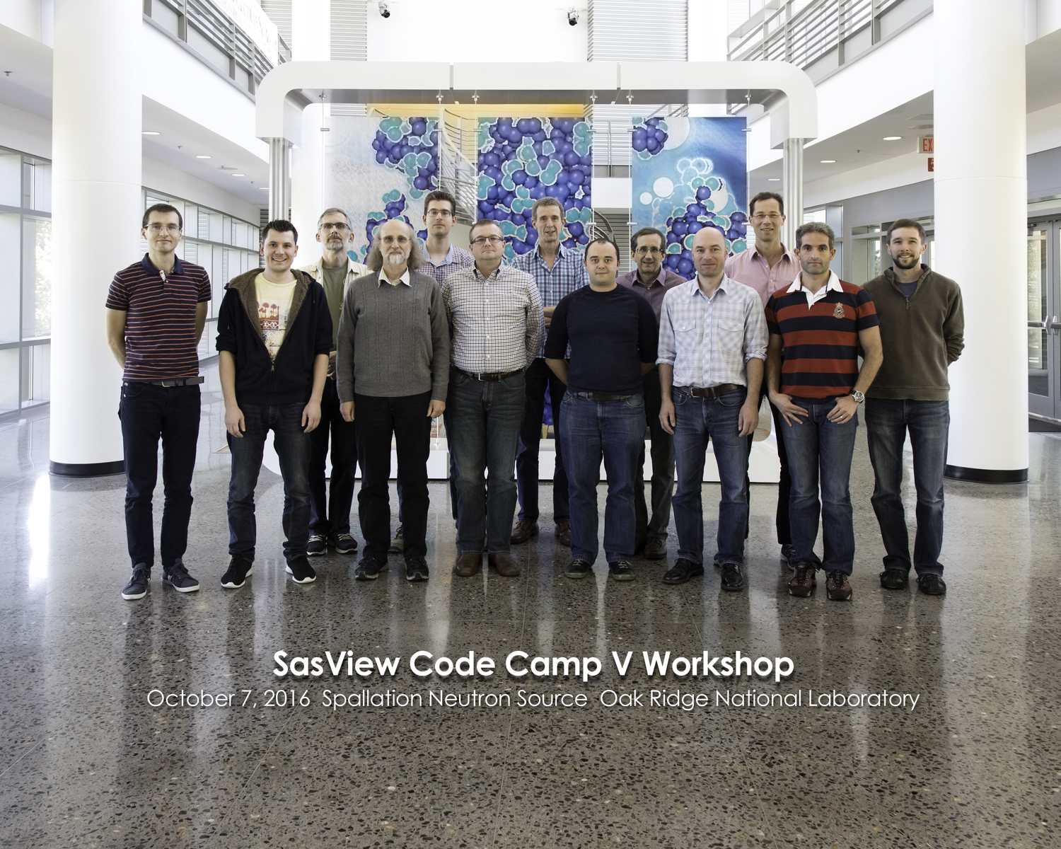
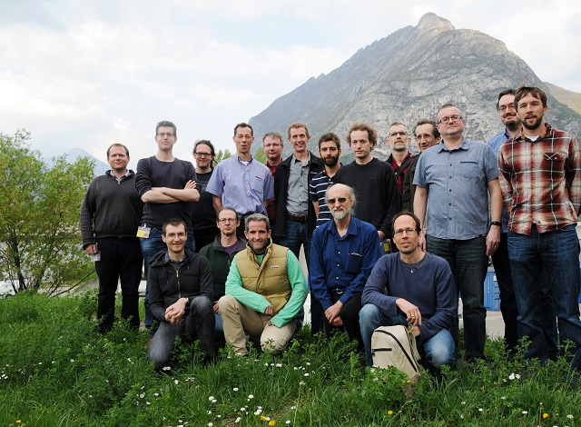
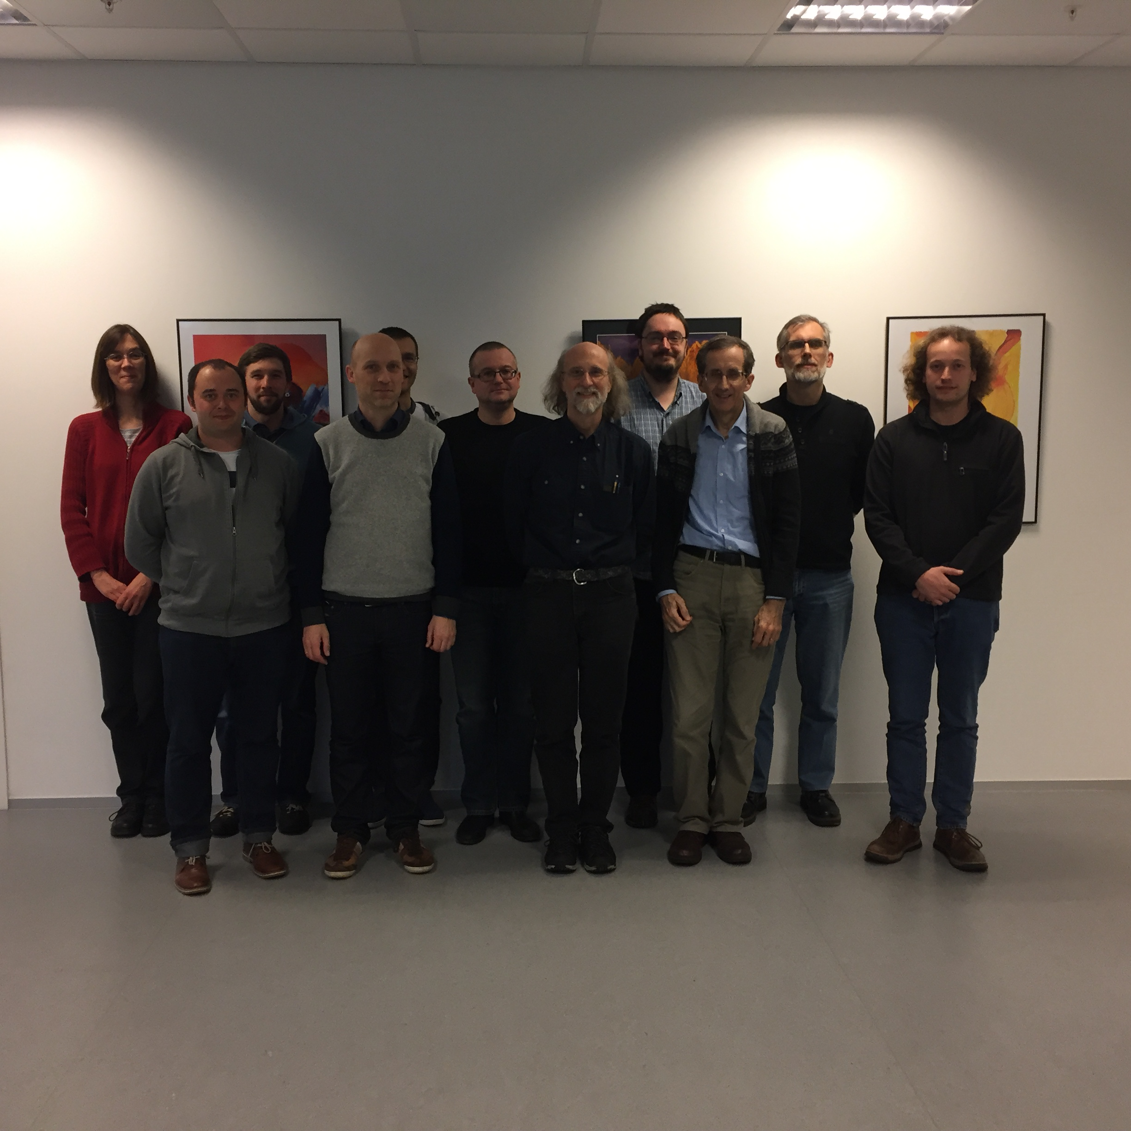
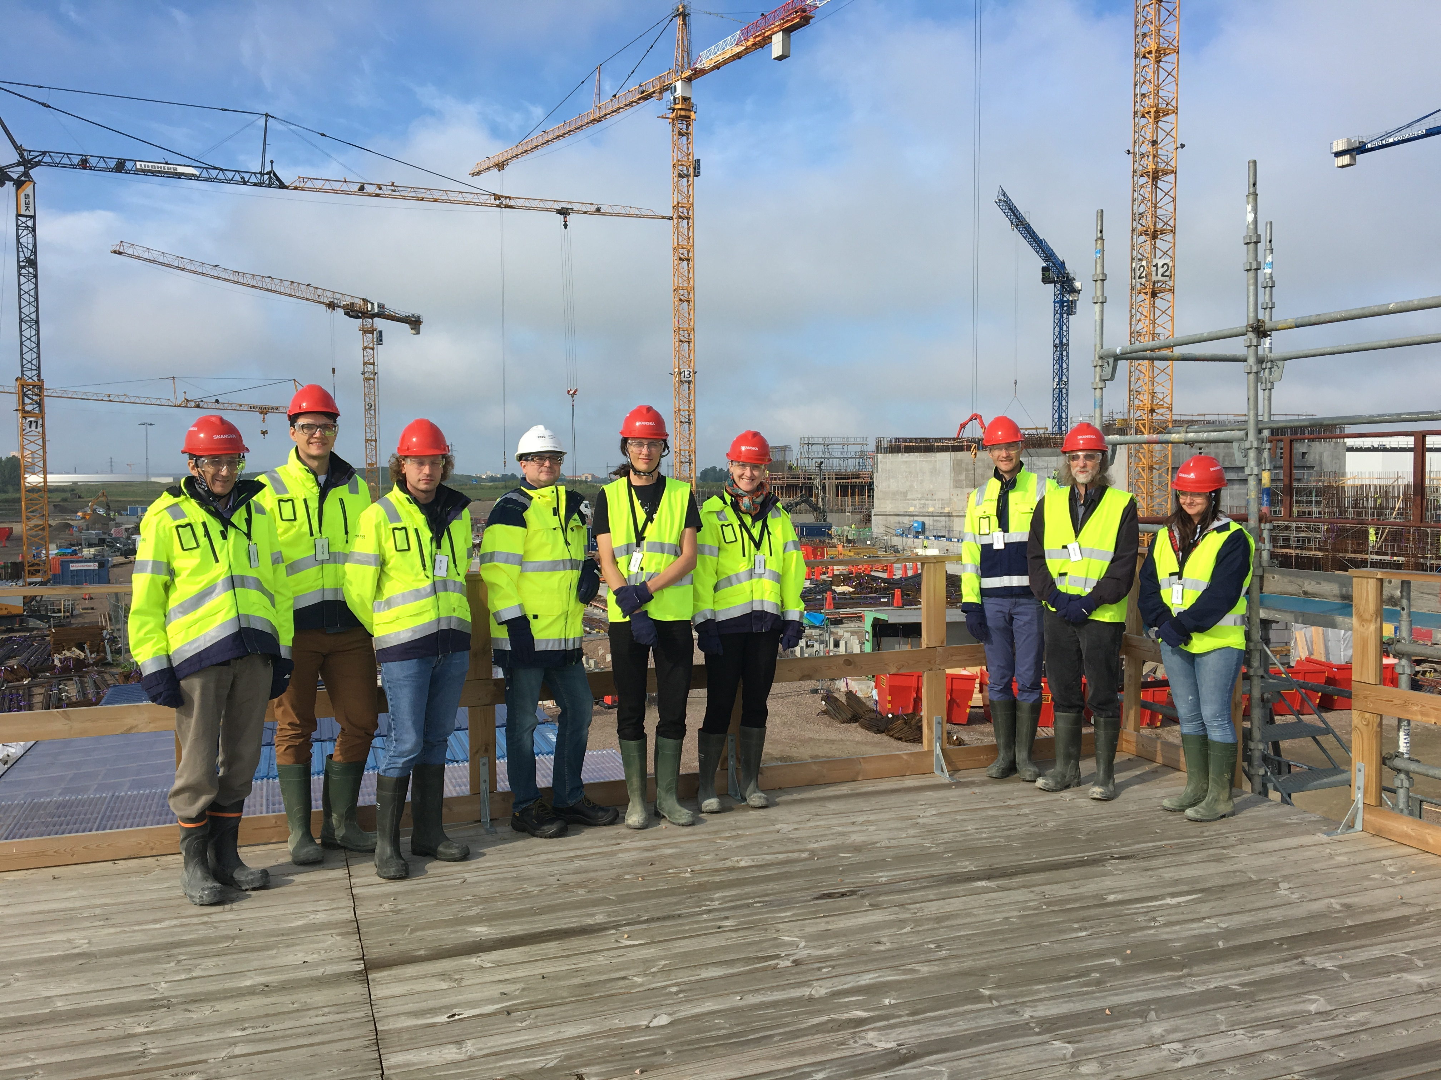
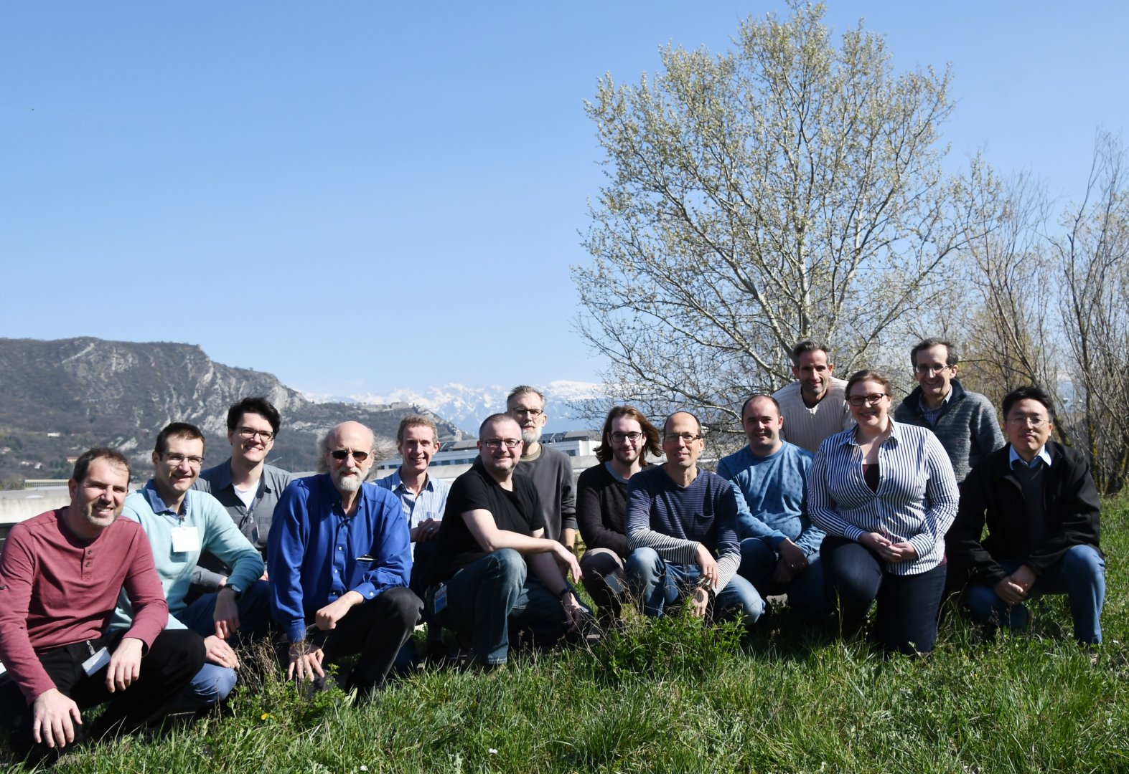
Status of SasView
2006; originates in NSF DANSE project
2013; transitions into a community project
~40 contributors from 9 organisations (~15 active at any one time)
twice monthly zoom calls
regular ‘camps’ & ‘hackathons’
small management team:
Paul Butler (NIST), Mathieu Doucet (ORNL),
Andrew Jackson/Wojciech Potrzebowski (ESS), Steve King (ISIS)

Slide 15
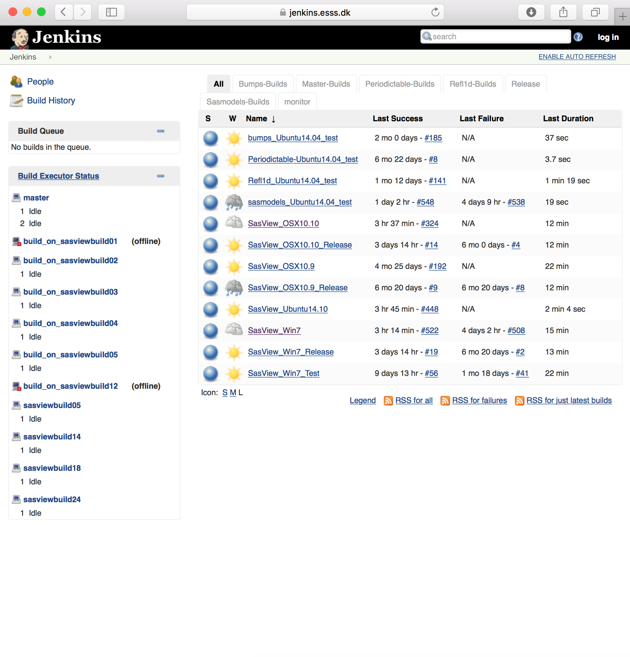
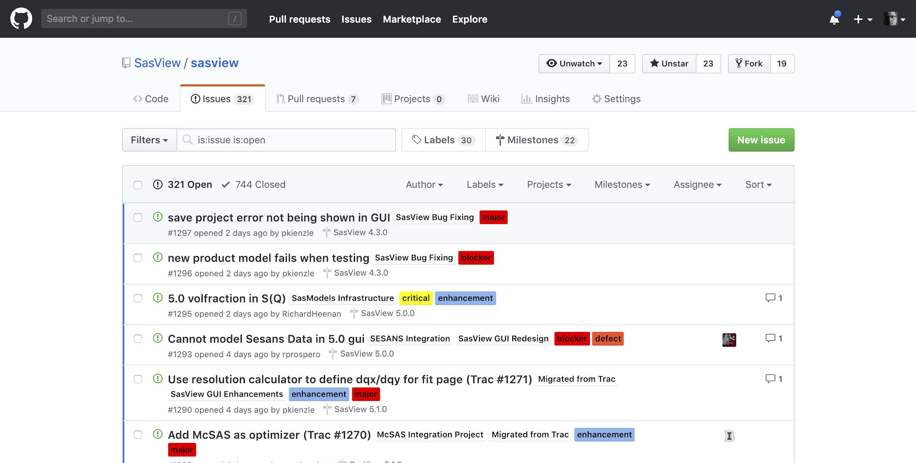
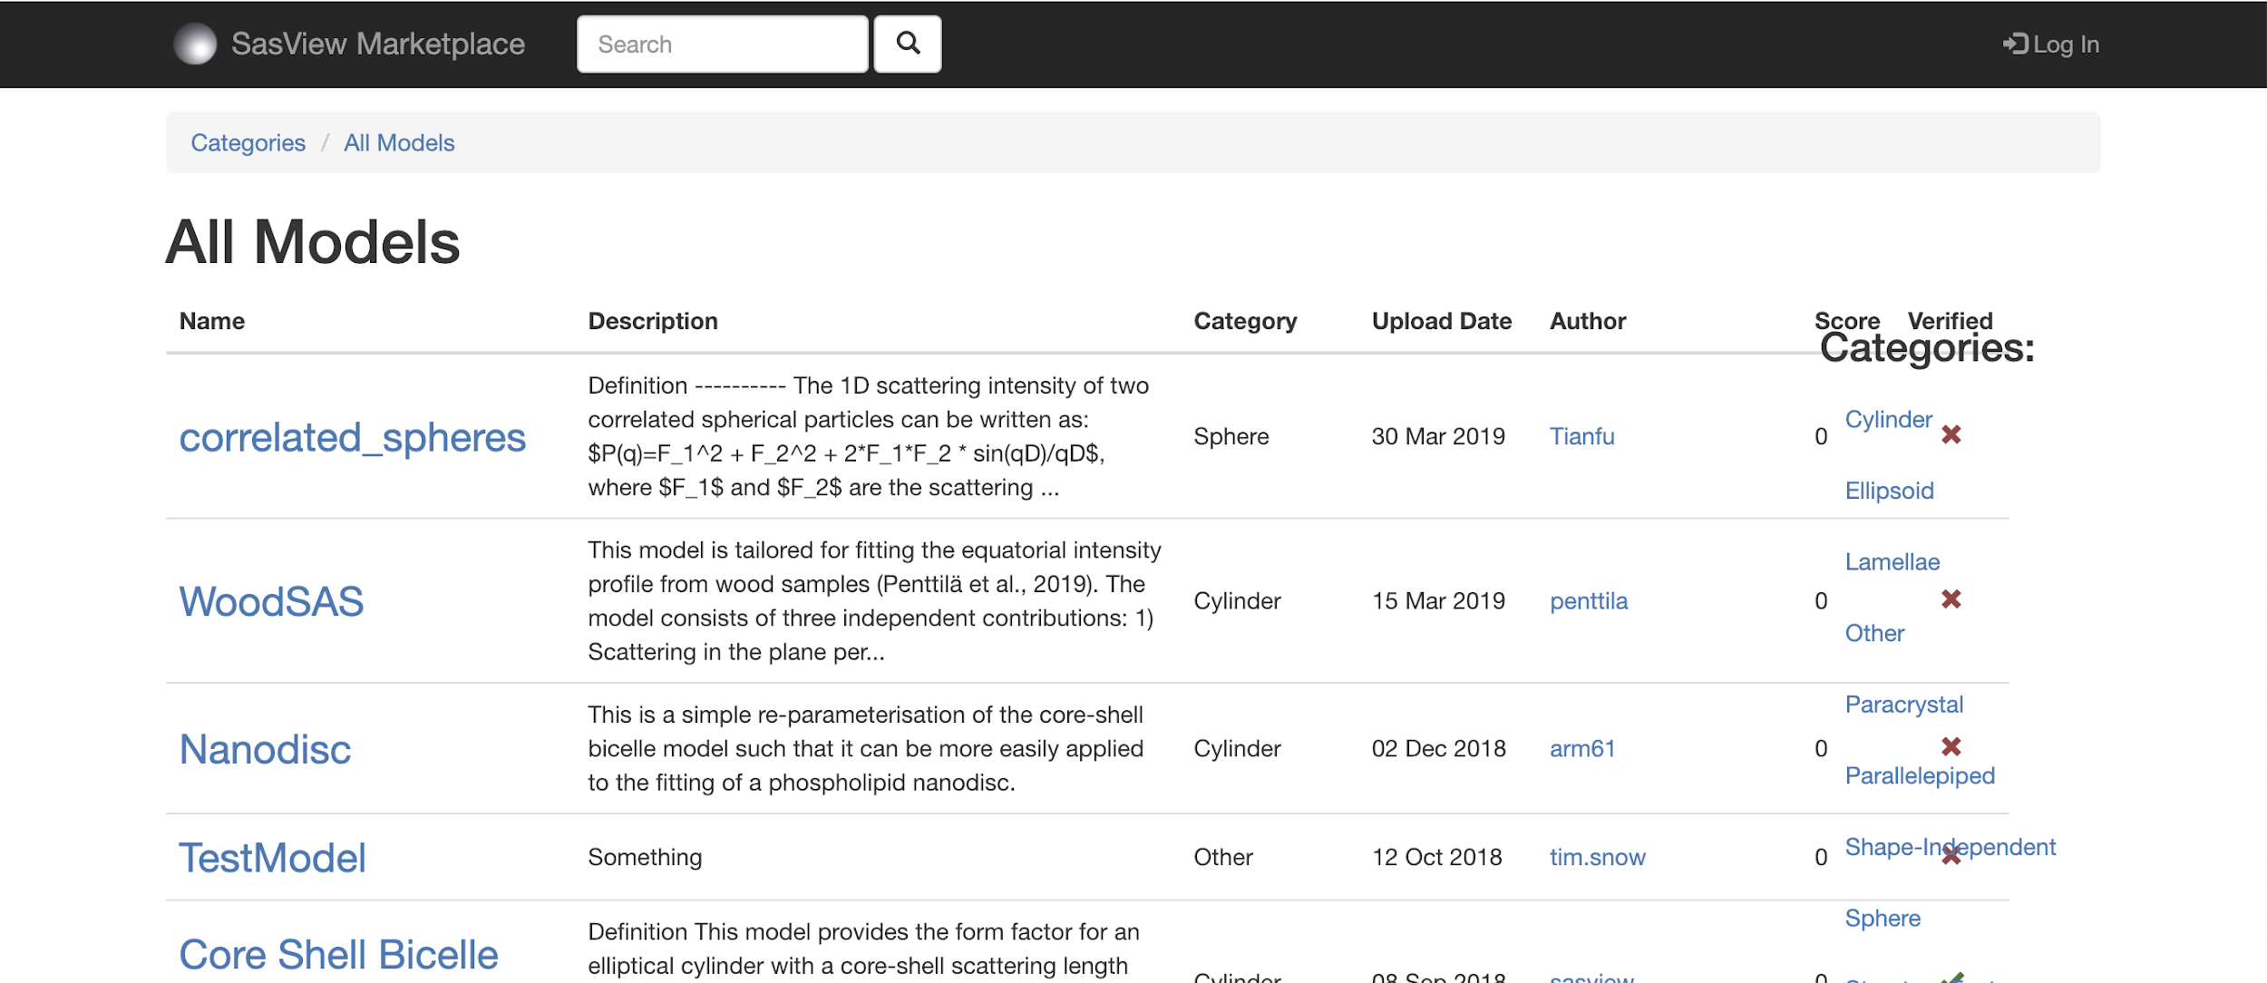



Open, Collaborative, Community Development
Code is open source and publicly hosted at Github
Released under BSD 3-clause license
Rolling 5 Year Roadmap
Code Hosting, Issue Tracking & Developer Wiki on Github
Automated Builds
Model Marketplace for Users to share their models
https://github.com/SasView
http://build.sasview.org/
http://marketplace.sasview.org
https://www.sasview.org

Slide 16
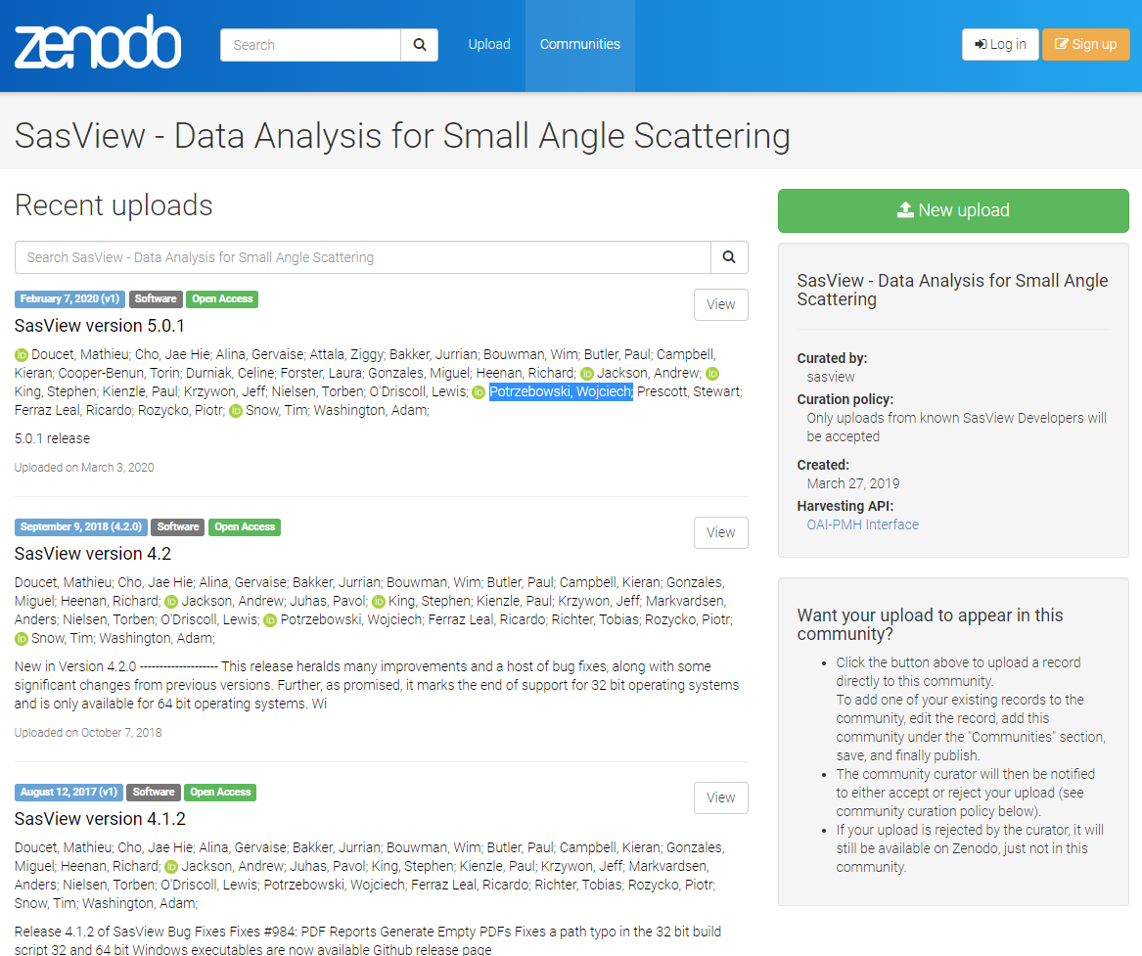
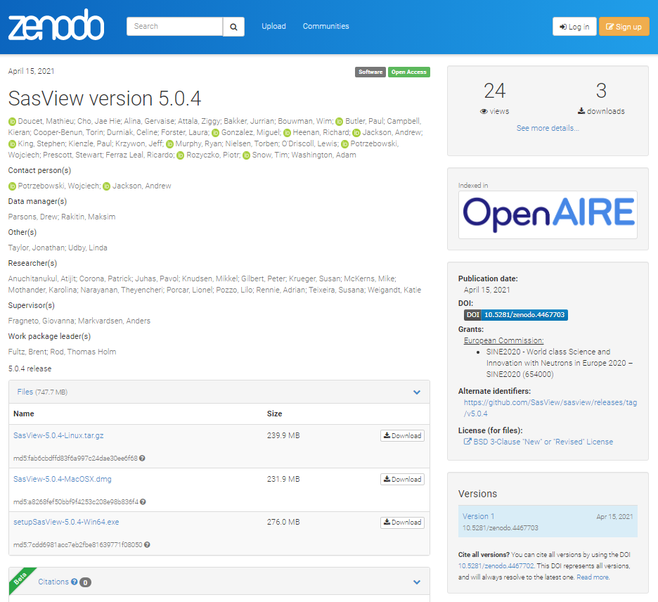
Open, Collaborative, Community Development
DOI for each release
https://zenodo.org/communities/sasview-analysis

Slide 17
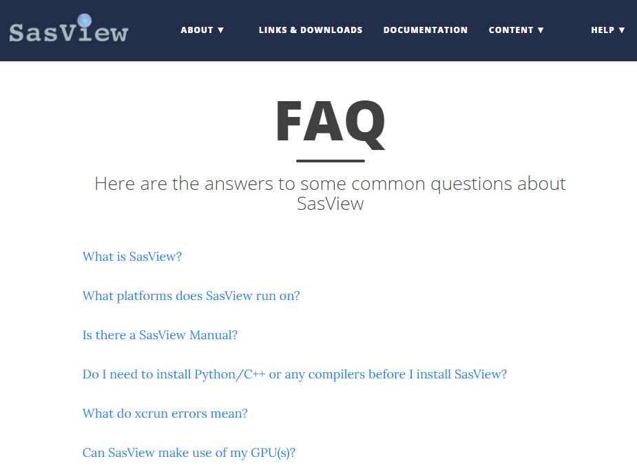
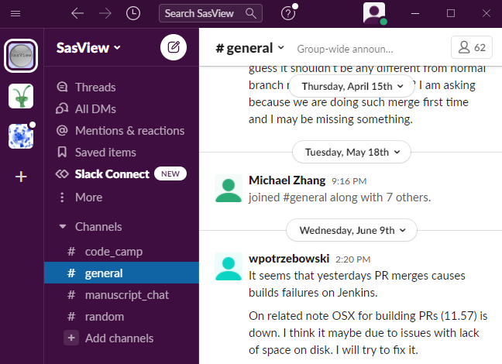
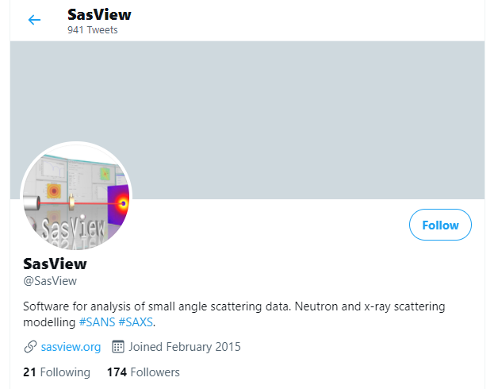
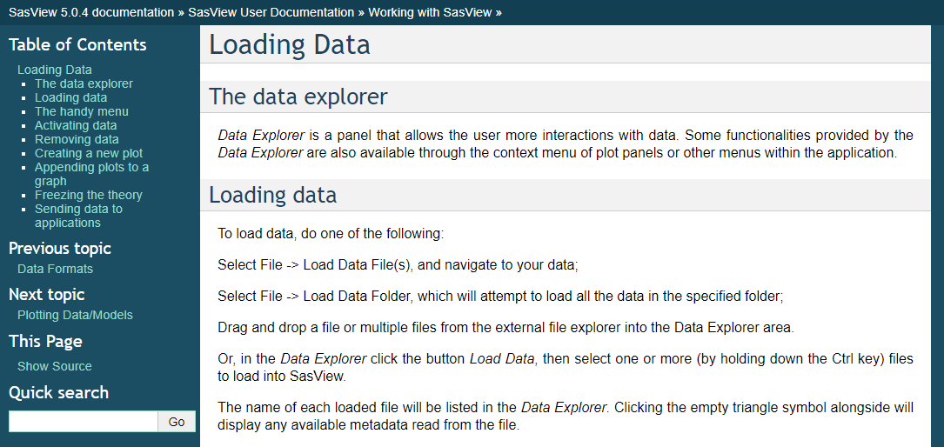
Open, Collaborative, Community Learning
Website
Documentation
in-program & online
Written Tutorials
Video Tutorials (YouTube)
Taught Courses
scattering schools/workshops
university courses
Bootcamps & regional workshops
e-Learning
Slack
Twitter
(Marketplace)
help@sasview.org
users@sasview.org

Slide 18
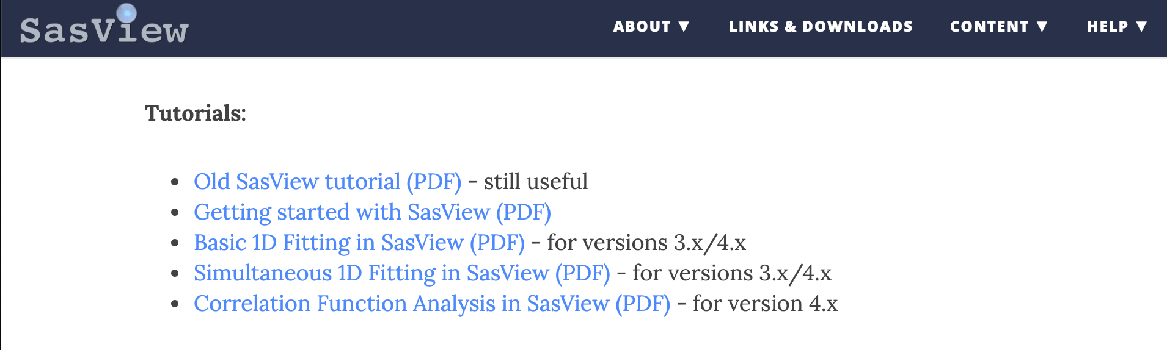
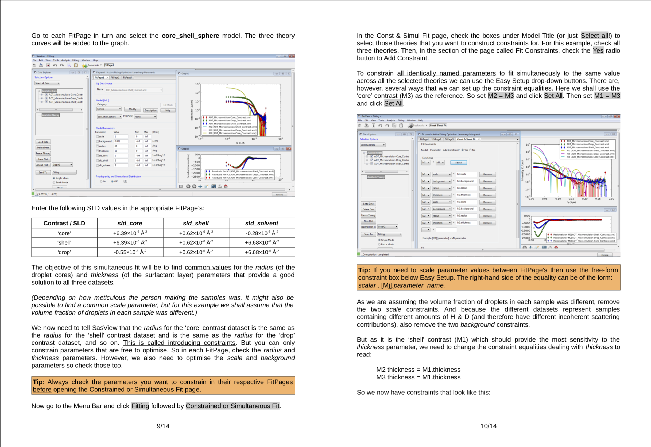
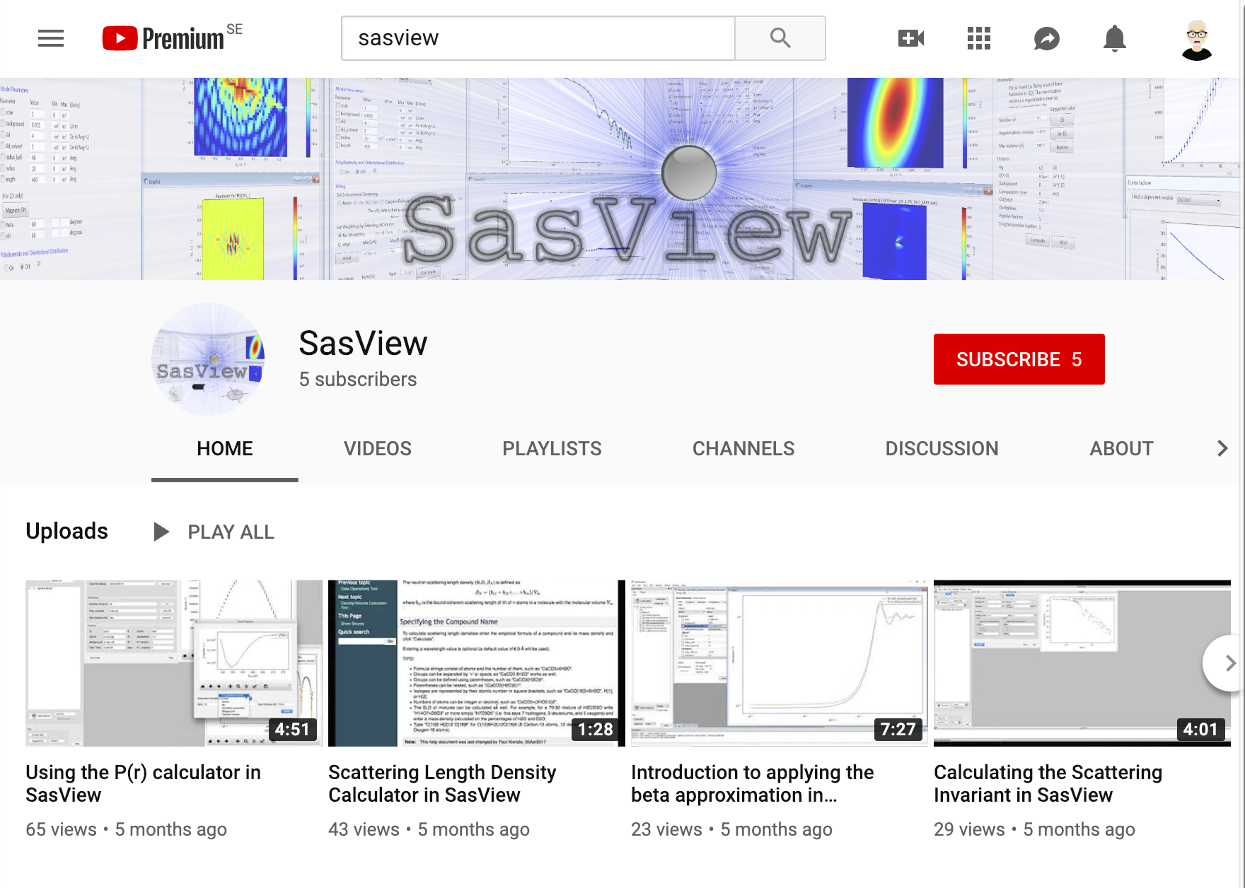
Open, Collaborative, Community Learning
Website
Documentation
in-program & online
Written Tutorials
Video Tutorials (YouTube)
Taught Courses
scattering schools/workshops
university courses
Bootcamps & regional workshops
e-Learning
Slack
Twitter
(Marketplace)
help@sasview.org
users@sasview.org

Slide 19
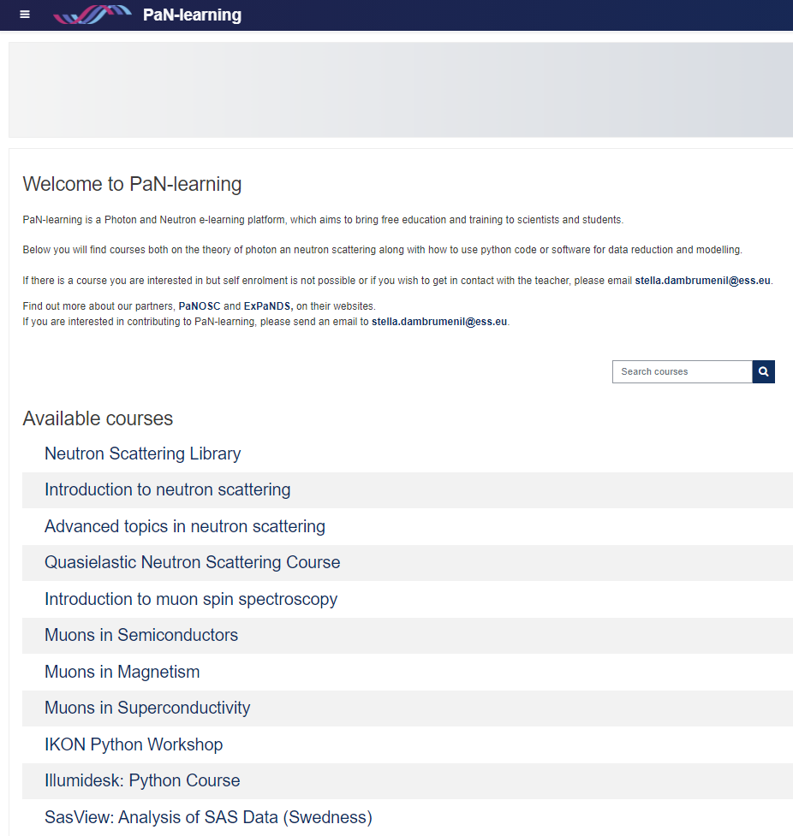

Open, Collaborative, Community Learning
Website
Documentation
in-program & online
Written Tutorials
Video Tutorials (YouTube)
Taught Courses
scattering schools/workshops
university courses
Bootcamps & regional workshops
e-Learning
Slack
Twitter
(Marketplace)
help@sasview.org
users@sasview.org
https://pan-learning.org/
All the work of ISIS Sandwich Student Michael Oakley

Slide 20
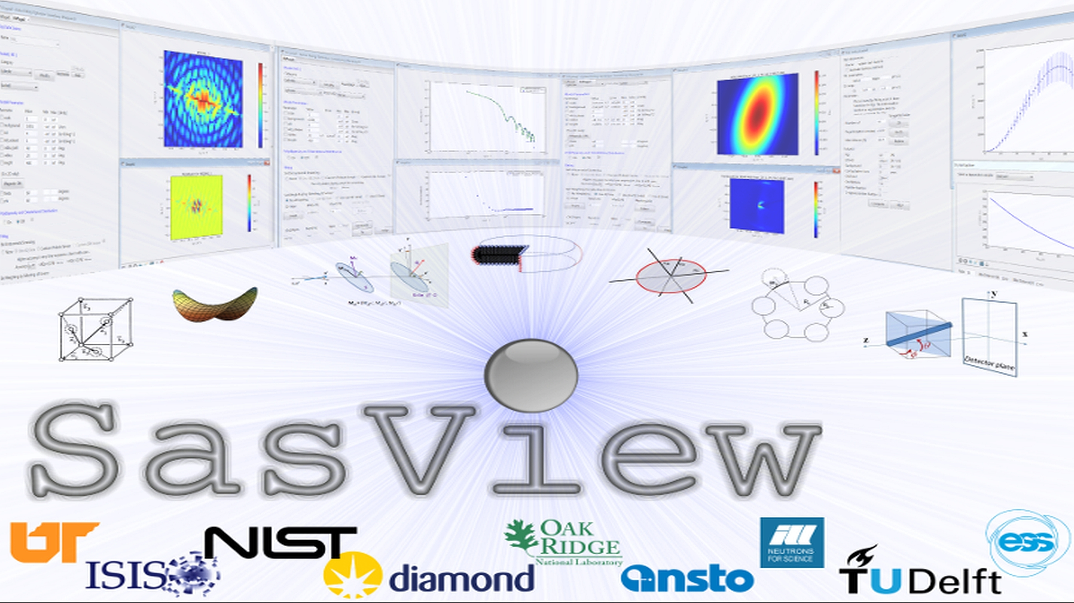

Slide 21
Model-Fitting 101
The objective of model-fitting is to find a model solution (theory) that:
describes the form of the experimental data
offers minimal uncertainty
has converged nicely
And above all is…
physically realistic !!!
“The fact, that A model fits your data, it is NOT proof that it is THE appropriate model.”
Jan Ilavsky, APS

Slide 22
Model-Fitting 101
Wherever possible, select a model/parameters using a priori knowledge:
ancillary data (EM, DLS, etc)
published literature
A model with more parameters is not always better than a model with fewer parameters!
Simultaneously fitting too many parameters is generally a bad idea!
at least, until the program is homing in on a solution
Here’s why…

Slide 23
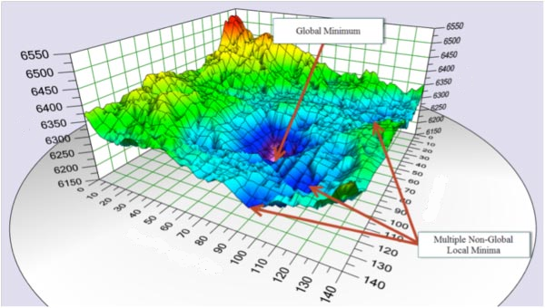
Model-Fitting 101
poorer
χ²
better
Parameter_2
Parameter_1
Image © http://www.theactuary.com/

Slide 24
Model-Fitting 101
Finding the global minimum → optimisation
you can have speed or robustness, but not (generally-speaking) both!
For speed: → gradient-descent algorithms
For robustness: → population algorithms
also called ‘evolutionary’ or ‘genetic’ algorithms
→ Bayesian (probability) algorithms
AI methods…
SasView features 5 optimisers…

Slide 25

SasView Optimisers
For speed: → gradient-descent algorithms
Levenberg-Marquardt
the tried-and-trusted workhorse found in every model-fitting package
use when you have a reasonable fit in a minimum & want the best values
but beware it finding local minima
Quasi-Newton BFGS
In-between:
Nelder-Mead Simplex
a good first choice (especially if your function is well-behaved)
For robustness: → population & Bayesian algorithms
Differential Evolution
DREAM
use when you need a really robust fit &/or want to explore correlations
‘bumps’
https://pypi.org/project/bumps/
Paul Kienzle, NIST
https://www.sasview.org/docs/user/qtgui/Perspectives/Fitting/optimizer.html

Slide 26
Time for a Demonstration!

Slide 27
Thanks to:
The members of the
SasView Development Team

Slide 28





e: help@sasview.org
www.sasview.org
@SasView
sasview.slack.com
Notes:
Th

Slide 29



e: help@sasview.org
www.sasview.org
@SasView
sasview.slack.com

